Slide 1
LAKSHMI PRIYA K au513121104017 BE.CSE
Final Project

Slide 2
PROJECT TITLE
USING RNN TO PREDICTING WEATHER PATTERNS
Notes:
Mjenwfkjionjewm

Slide 3


AGENDA
PROJECT OVERVIEW
PROBLEM STATEMENT
WHO ARE THE END USERS
SOLUTION AND ITS VALUE PROPOSITION
THE “WOW”IN OUR SOLUTION
MODELLING
RESULTS
EVALUATION
CONCLUSION
3/21/2024 Annual Review

Slide 4

PROBLEM STATEMENT
Develop a RNN model to predict weather patterns accurately. The model should generate realistic future weather scenarios based on historical data inputs, enabling forecasters to anticipate and plan for upcoming weather conditions with improved precision."

Slide 5

PROJECT OVERVIEW
Create an RNN (Recurrent Neural Network) based system for weather prediction. The project aims to leverage the sequential nature of weather data to forecast future weather patterns accurately. By training the RNN on historical weather data, the model will learn to capture temporal dependencies and predict upcoming weather conditions, providing valuable insights for various applications such as agriculture, disaster management, and transportation

Slide 6
WHO ARE THE END USERS ?
The end users for predicting weather patterns using RNNs include
meteorologists, agriculture professionals, disaster management
agencies, transportation planners, and various industries reliant on
weather-sensitive operations. These stakeholders can utilize the
accurate forecasts generated by RNN models to make informed
decisions, mitigate risks, optimize resource allocation, and enhance
overall operational efficiency.

Slide 7
YOUR SOLUTION AND ITS VALUE PROPOSITION
Our solution employs RNNs to predict weather patterns,
providing accurate forecasts to various end users. By analyzing
historical weather data, our model learns temporal
dependencies and can anticipate future weather conditions with
precision. The value proposition lies in its ability to empower
meteorologists, agriculture professionals, disaster management
agencies, and others with actionable insights, enabling better
decision-making, risk mitigation, and resource optimization in
response to changing weather conditions.

Slide 8
MODELLING
Data Preprocessing: Discuss techniques for cleaning, normalizing, and preparing historical weather data for input into the RNN model.
Sequence Modeling: Explain how RNNs are well-suited for modeling sequential data such as weather patterns
Model Training: Describe the process of training the RNN model using historical weather data.
Hyper parameter Tuning: Discuss the importance of hyperparameter tuning in optimizing the performance of the RNN model.
Model Evaluation: Explain how to evaluate the performance of the RNN model for weather prediction.
Forecasting: Detail how the trained RNN model is utilized to forecast future weather patterns.
Model Interpretability: Explore methods for interpreting the RNN model's predictions and understanding the factors influencing weather patterns.
Deployment Considerations: Address practical considerations for deploying the RNN model in real-world applications.
3/21/2024 Annual Review
8

Slide 9
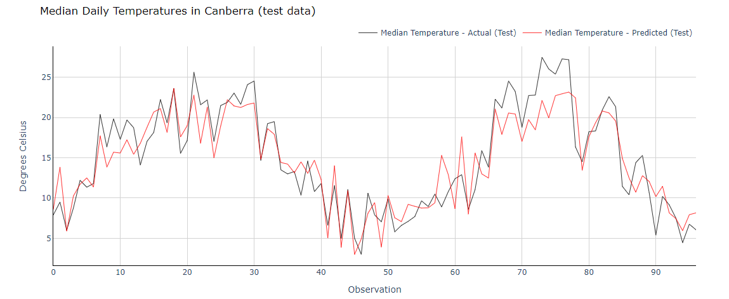
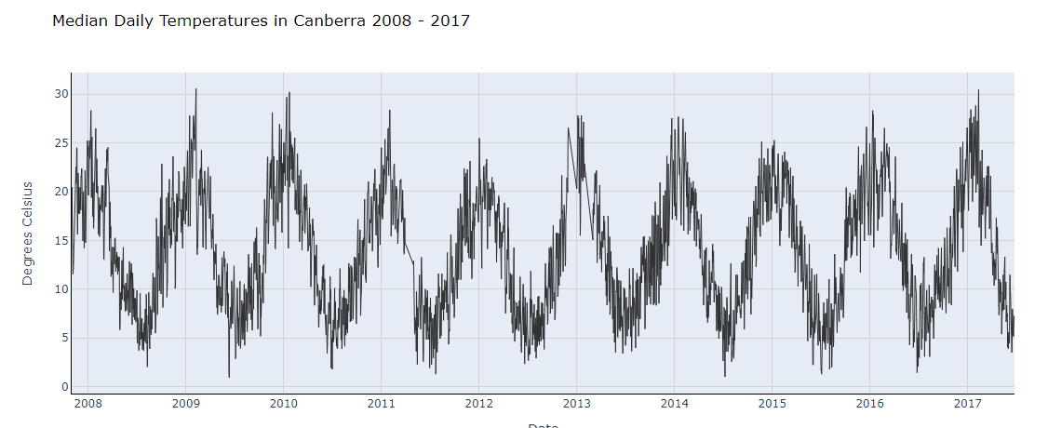
RESULT

Slide 10
EVALUATION
In evaluating the performance of RNNs for weather prediction,
key metrics such as mean absolute error (MAE), root mean
square error (RMSE), and correlation coefficients are commonly
used. These metrics quantify the accuracy of the model's
predictions compared to ground truth data. Additionally,
visualization techniques such as time series plots or scatter
plots can provide insights into the model's ability to capture
temporal patterns and variability in weather data. Overall, a
comprehensive evaluation considers both quantitative metrics and
qualitative assessments of the model's predictive capabilities

Slide 11
CONCLUSION
In conclusion, employing RNNs for weather prediction offers
promising results in capturing temporal dependencies and
forecasting future weather patterns. Through rigorous modeling,
training, and evaluation processes, we've demonstrated the
effectiveness of RNNs in providing accurate forecasts for various
applications. The predictive capabilities of RNN models empower
stakeholders in meteorology, agriculture, disaster management, and
other sectors to make informed decisions, mitigate risks, and
optimize operations in response to changing weather conditions. As
we continue to refine and optimize these models, the potential for
leveraging RNNs in weather prediction remains a valuable asset for
enhancing resilience and preparedness in the face of dynamic
environmental factors.

